Slide 1

Empowering the Nation
SME

Slide 2
Background of company
We were asked to design a logo, web page and mobile application for a local small- to mid-size enterprise (SME) to advertise their business, receive requests for information from potential customers. SME is an initiative by Precious Radebe to provide skills training for domestic workers and gardeners. The skills provided in these learnership courses make the domestic workers and gardeners more marketable when seeking employment and enables better pay because of these skills gained. The company name is “Empowering the nation” which was established in 2018. It offers courses in Johannesburg to hundreds of domestic workers and gardeners. There are six weeks courses and six months courses. The six-month courses offer first aid, sewing, landscaping, life skills and the six-week courses are child minding, cooking and Garden maintenance.

Slide 3
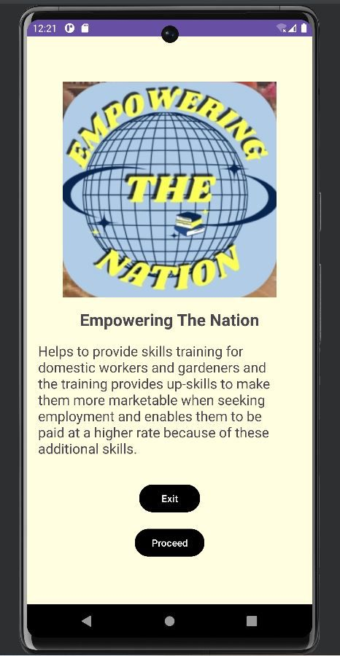
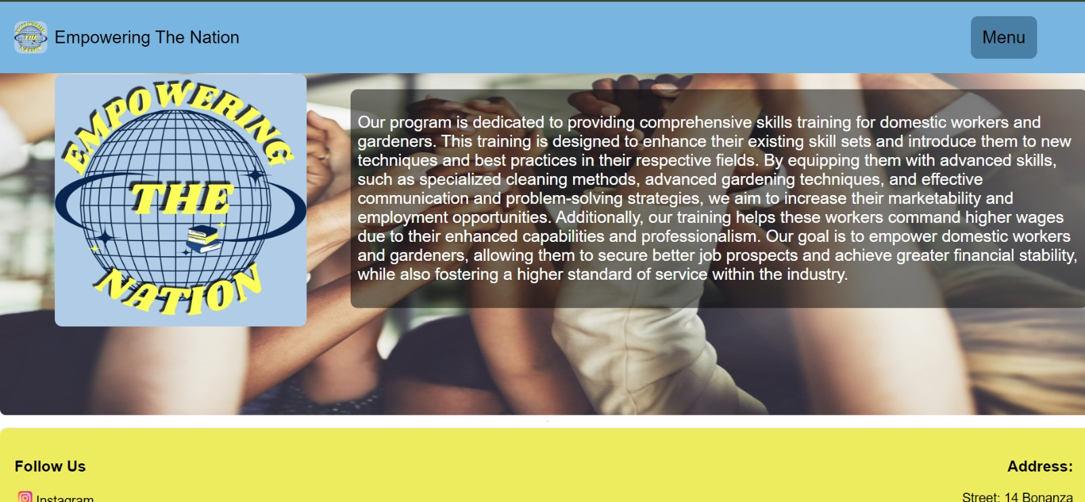
Application and Website home pages
The App
The Website

Slide 4
Both our application and website have the logo on their cover pages and a brief explanation of the company Empowering the Nation is all about and how it will help those who need it.

Slide 5
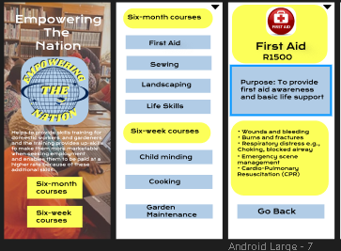
The Apps Wire Frames
These are the wire frames of the app that we used to design the app. They give a simple clue of the app will look after being fully created

Slide 6
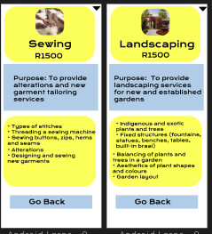
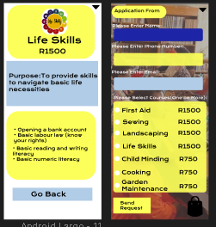
More App wire frames

Slide 7
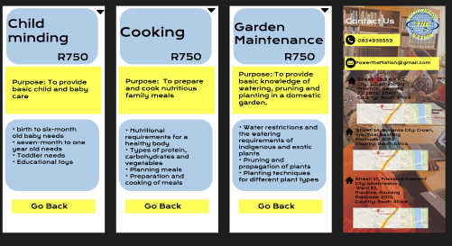

Slide 8
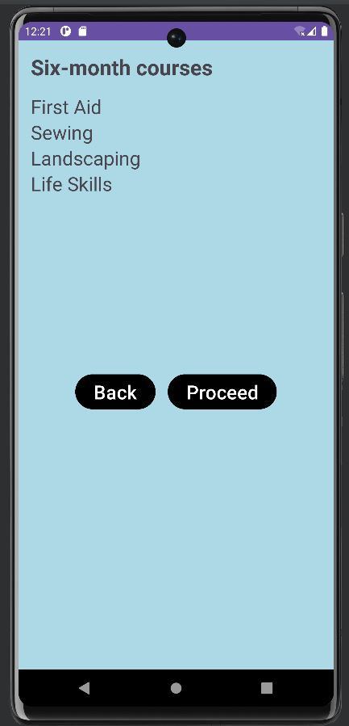
The App
This is the home page and 1st screen of the app. The home page has an exit button which allows to exit the app and a proceed button which allows to continue to 1st page of the app. The 1st page shows list of courses of the six-month courses. It has a back button which allows you to go back to the home and a proceed button which takes you to the next screen of the app.

Slide 9
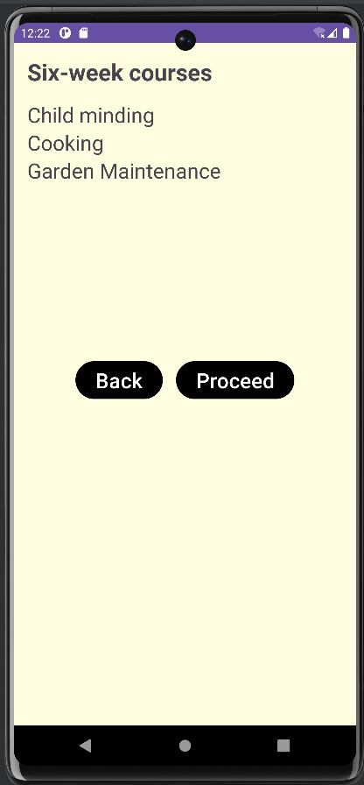
1st and 2nd screens
The proceed button in the 1st screen leads to the 2nd screen which shows you the list of courses in the six-month courses. The 2nd screen has a back button that leads you back to the 1st screen and a proceed button that leads to the next screen.

Slide 10
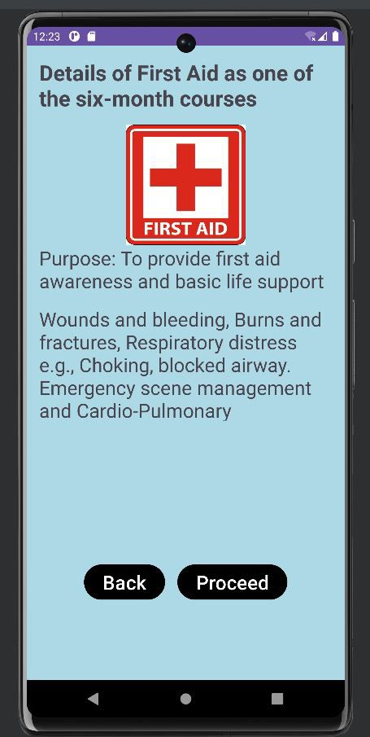
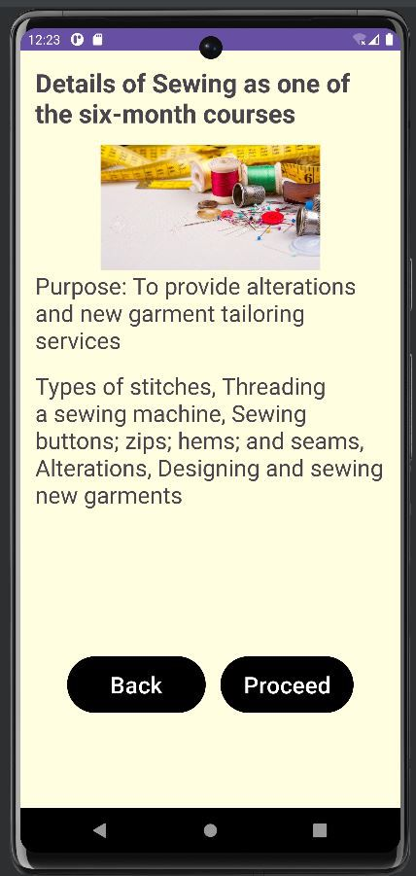
The six-month courses: 3rd and 4th screens
The 3rd screen gives you details of one of the six-month courses and gives a brief summary of what this course is all about and a first Aid logo at the top showing you that this is the first Aid course. It allows has a back button which allows you to go back and a proceed button to go to the next screen. The 4th screen also gives you details of one the six-month courses and a summary of the purpose of the course. It also has a back button and a procced button.

Slide 11
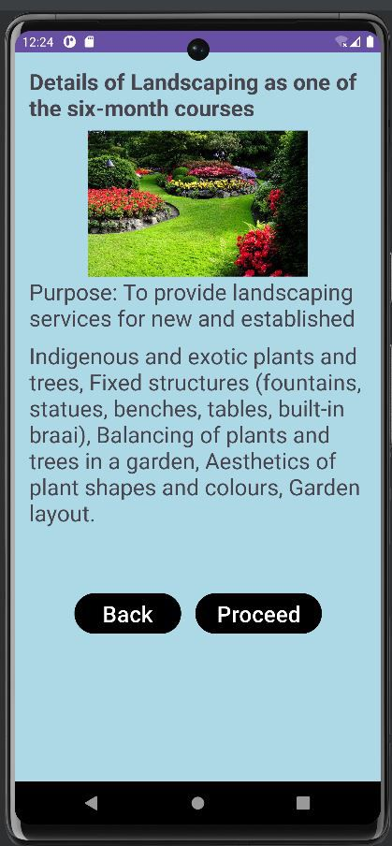
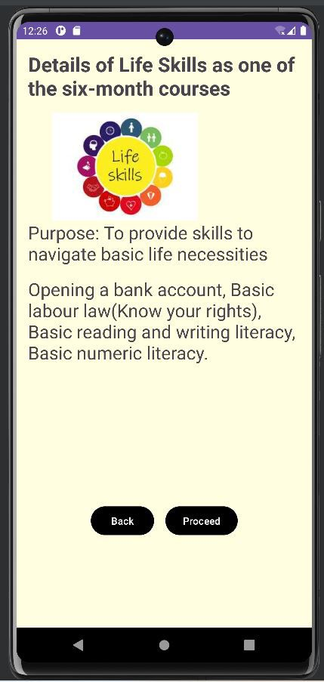
5th and 6th screens
More or less the same the 5th and 6th screens are very similar to the 3rd and 4th screens as they give details of one the six-month courses and a summary of what each course is about. They both have back buttons to go back and proceed buttons.

Slide 12
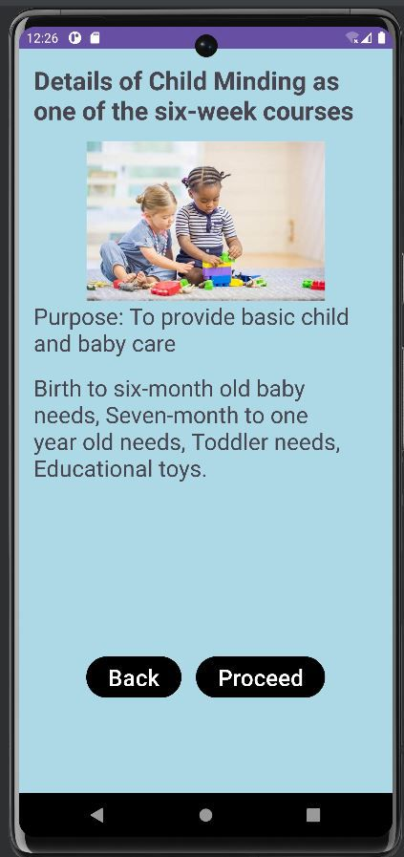
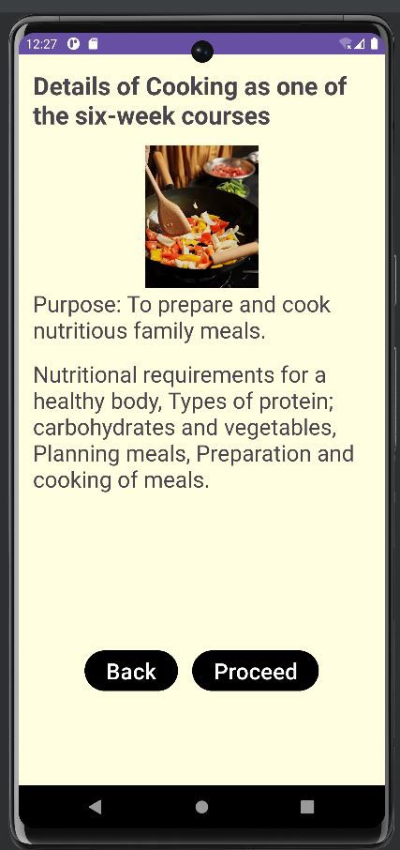
The six-week courses: 7th and 8^{th screens}
The 7th screen gives you details of one of the six-week courses and gives a summary of what this course is all about and a child-minding logo at the top showing you that this is the child-minding course course. It allows has a back button which allows you to go back and a proceed button to go to the next screen. The 8th screen also gives you details of one the six-week courses and a summary of the purpose of the course. It also has a back button and a procced button.

Slide 13
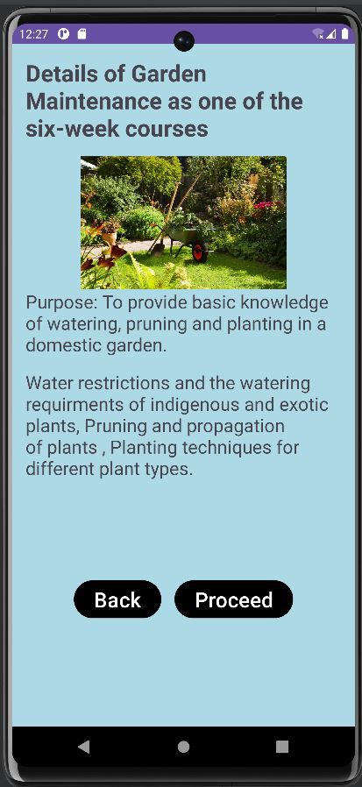
9th screen
The 9th just like the 7th and 8th screens gives a summary of the course and a logo to show you what the course is about. It has a back button and proceed button just like all the other screens.

Slide 14
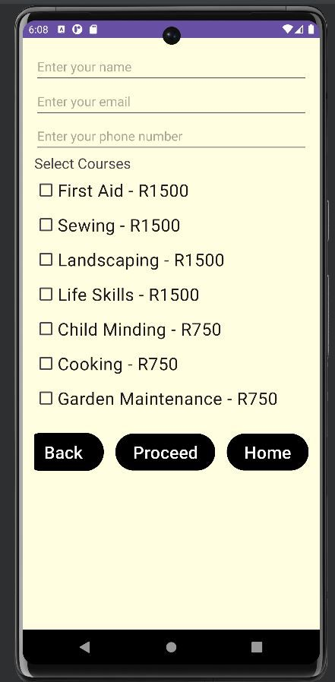
The application form screen
This screen is where the applicant is able to select the courses of their choosing by entering their names, phone number, email address and selecting their courses by ticking the course they want. It also has a back button and a proceed button just like other pages. It also gives the applicant the prices of the courses.

Slide 15
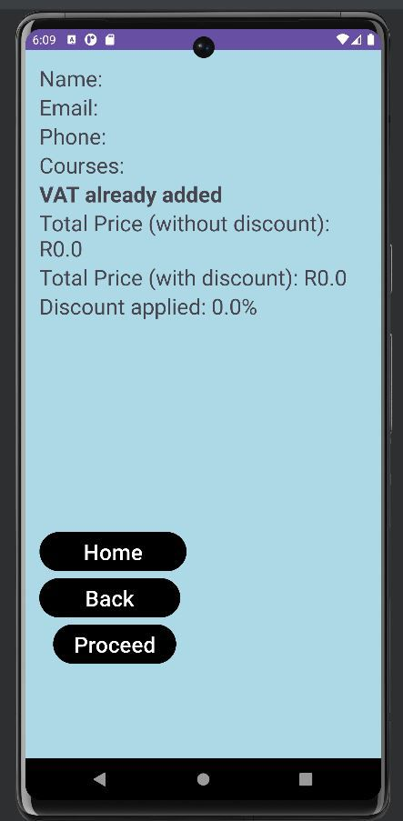
The applicant form screen
This screens shows the applicant their name, phone number, email address, courses taken and the total price of the total courses. If the applicant has selected two courses they get a 5% discount, three courses selected they get a 10% discount and more than three courses selected get a 15% discount. It also has a back button and proceed button.

Slide 16
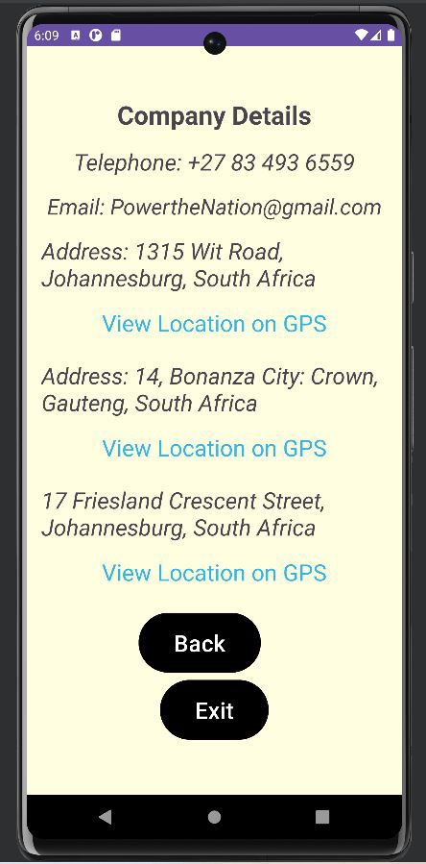
The contact us screen
The contact us screen gives the applicant the company details and contact details so that they are able to reach us when they need to. It also allows the applicant to get our locations as they can use the link provided to get our location. It has a back button and a exit button to exit the app.

Slide 17
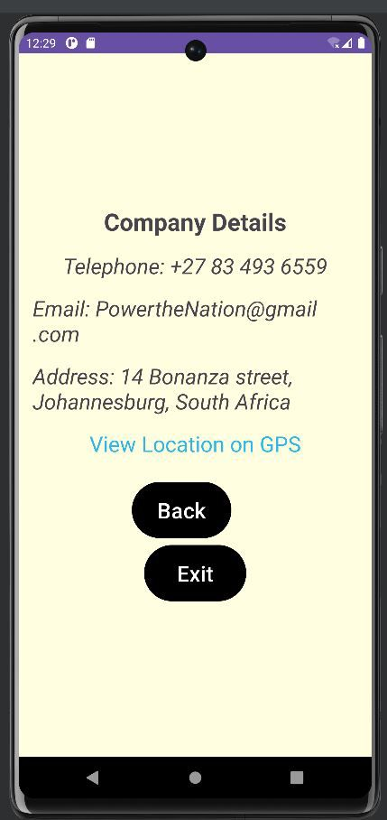
App creation
We used android studios to code our app. We used Kotlin language to code the functionality of the app

Slide 18
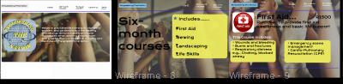

The Website wire frames
These are the wire frames of the website that we used to design the website. They give a simple clue of the website will look after being fully created and is running.

Slide 19

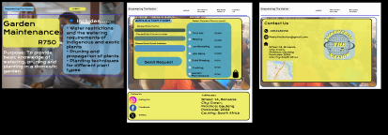
More Website wire frames

Slide 20
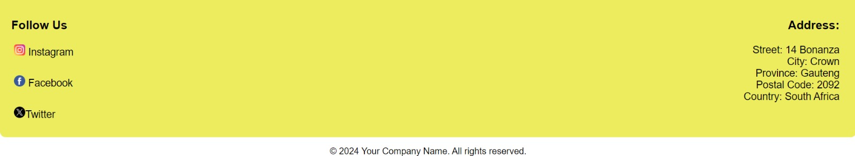
The Website
This is the home page of the website and it gives a brief summary of what the company is about. It also gives the social media platforms you can follow us on and gives the applicant our address.

Slide 21

Six-month courses page
This is the six-month page which shows all the six-month courses and a menu button on the top right-hand corner which allows you to go back to the home, contact us, apply now, six-month and six-week pages.

Slide 22
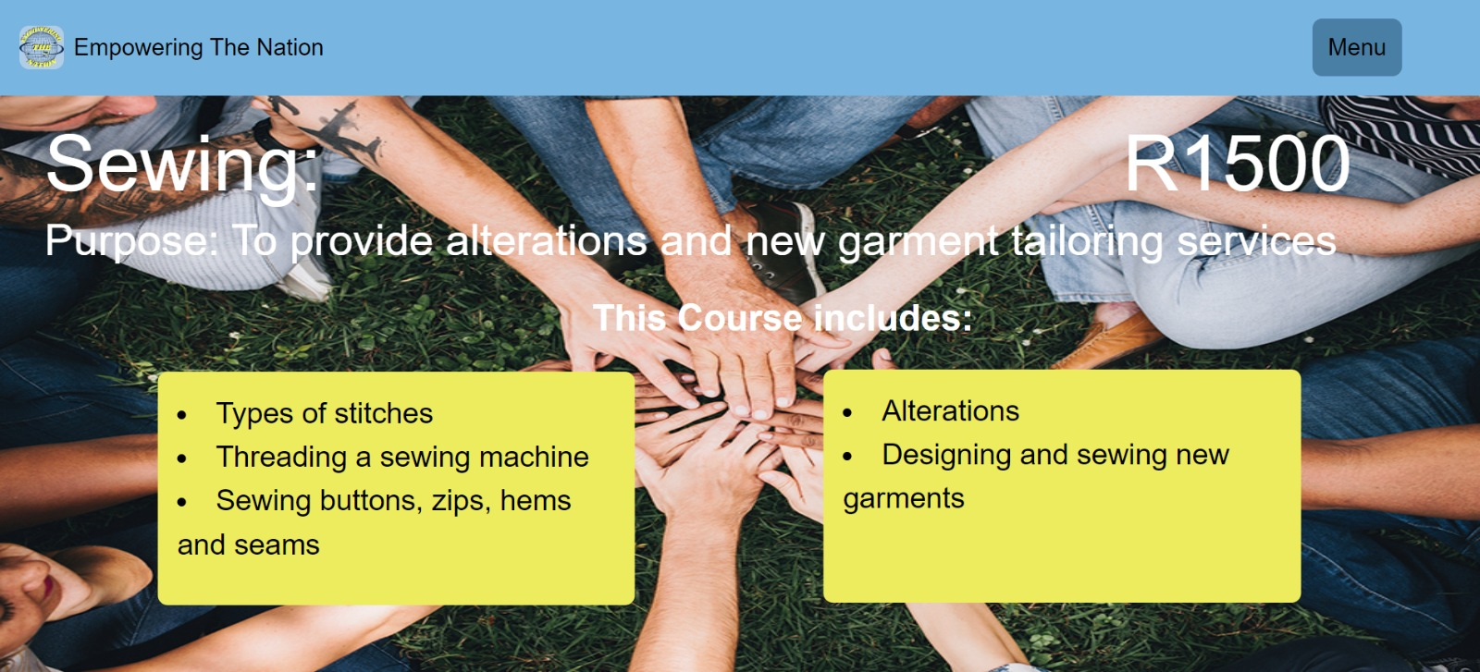
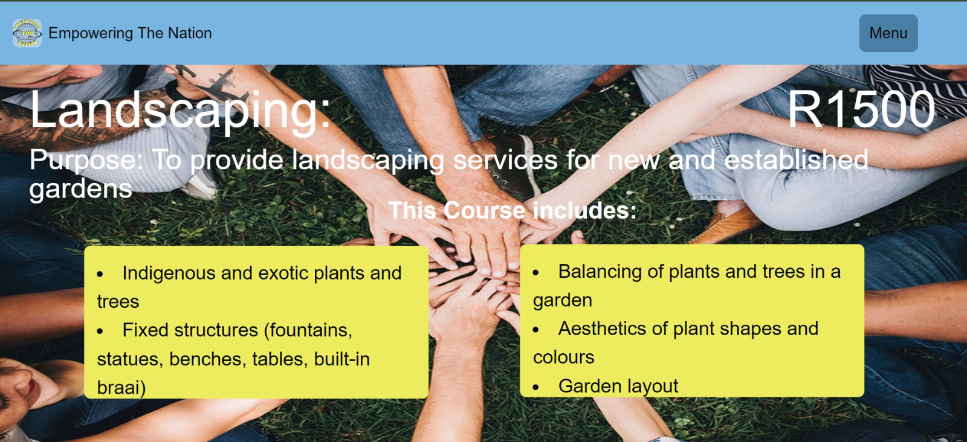
Sewing and landscaping pages
These are the sewing and landscaping two of the six-month courses. They give the applicant the prices of the courses and they both have the menu button at the top corner in the header. They give you the purpose of the course and what skills you will gain doing this course.

Slide 23
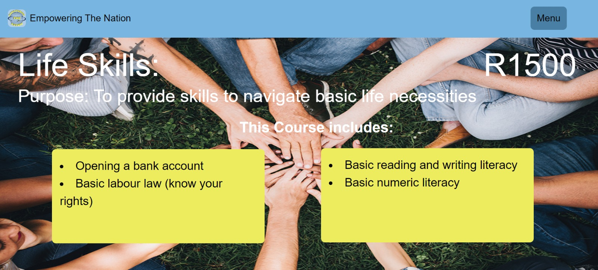
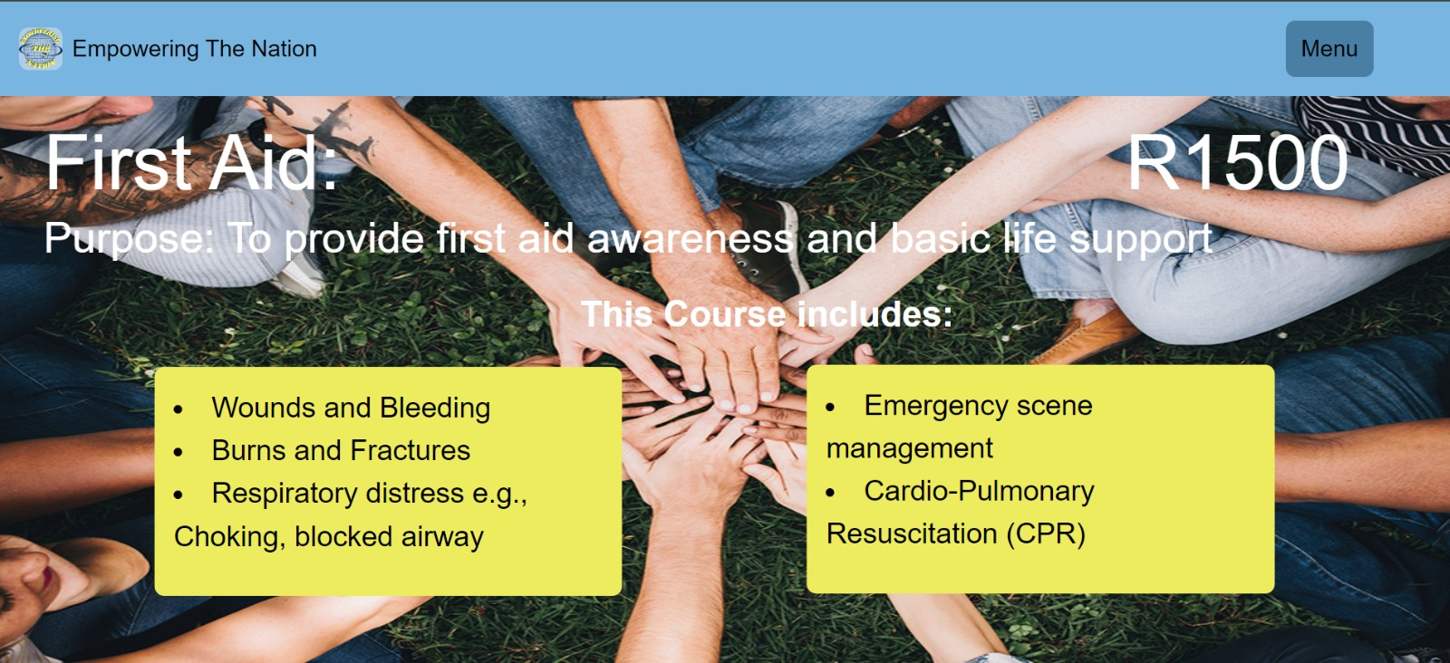
Life skills and first Aid page
These are the life skills and first aid two of the six-month courses. They give the applicant the prices of the courses and they both have the menu button at the top corner in the header. They give you the purpose of the course and what skills you will gain doing this course.

Slide 24

The Six-week courses
This is the six-week page which shows all three six-week courses and a menu button on the top right-hand corner which allows you to go back to the home, contact us, apply now, six-month and six-week pages just like the six-month course page is able to link these pages.

Slide 25
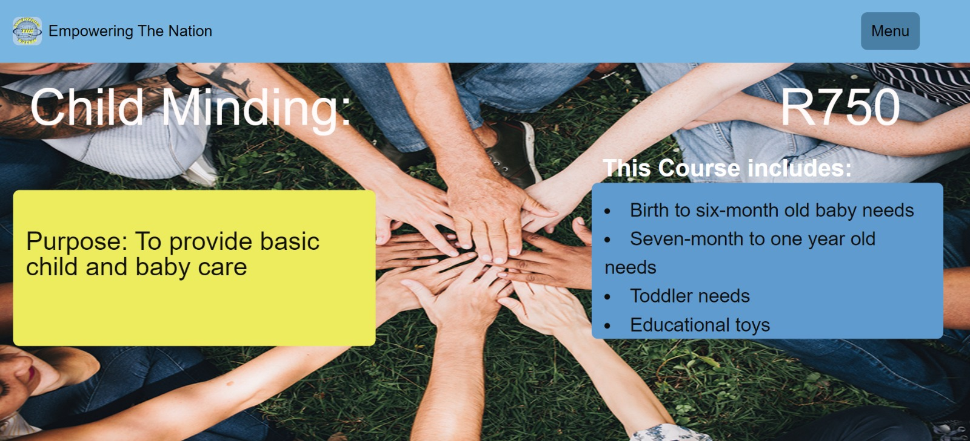
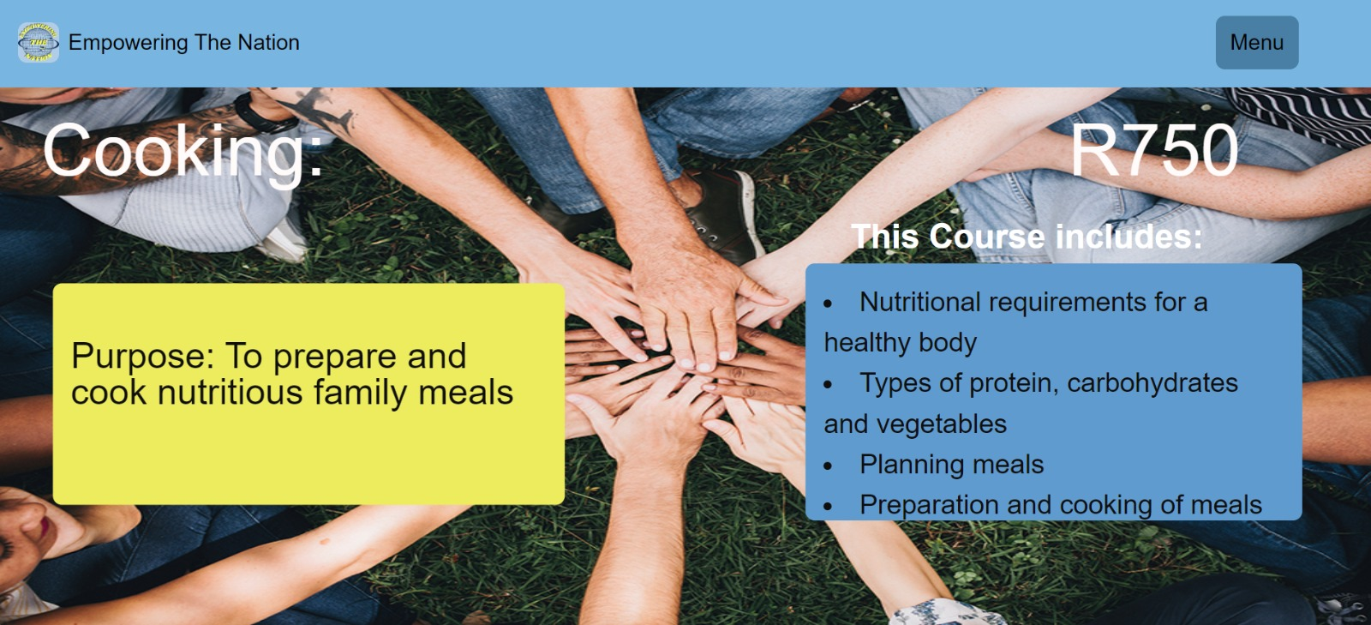
Child minding and Cooking courses
These are the child minding and cooking two of the six-week courses. They give the applicant the prices of the courses and they both have the menu button at the top corner in the header just like all the other pages. They give you the purpose of the course and what skills you will gain while doing this course.

Slide 26

Garden Maintenance page
This is the last page of the six-week courses and just like the other pages it has a menu button, the price of the course, the purpose of the course and what skills you gain while doing the course.

Slide 27
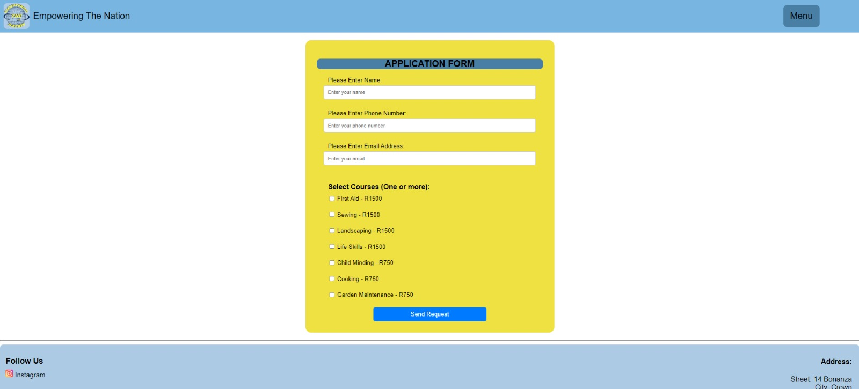
The Application form page
This is the application form where the applicant is able to enter their name, phone number and email address. This is where they are able select the courses of their choosing, showing the prices of the courses. There is a send request button that takes your form. The footer also shows social platforms you can follow us on and our address.

Slide 28

Invoice page
This is the invoice page just like app the applicant gets their invoice the courses they have chosen to take and where they are able to view the total cost of their spendings. Just like the app one course is 5% discount, two courses gets a 10% and three or more courses is a 15% discount. The calculations is done in the bac

Slide 29
Website Creation
We used html language to code the website structure and everything about how it will look. We then used CSS to design and add color to the website and make it look nice. We used java script for the functionality of the website such as the application form and the calculations.

Slide 30
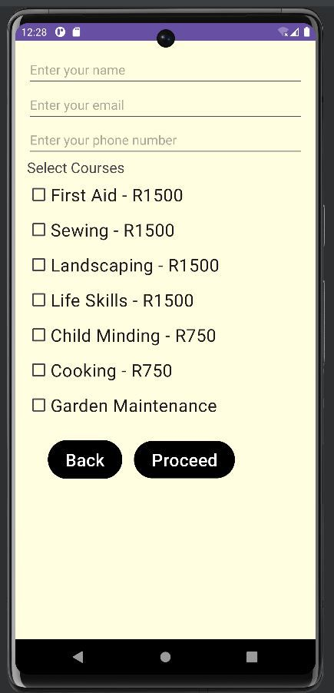
We created an app and website that would be easy to use for everyone. The app and website can both be used on android devices and easily accessible.
App
Website

Slide 31
End of Presentation

